Slide 1

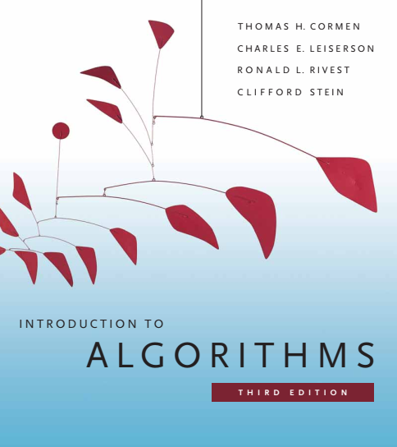
Design and Analysis of Algorithms
Dr. Sajid Iqbal
sajidiqbal.pk@gmail.com
Reference Book
Introduction to Algorithms 3rd Edition By Thomas H. Cormen et. al.
https://mitpress.mit.edu/books/introduction-algorithms-third-edition
COMEDXD

Slide 2
Analysis of The Quick Sort
Time complexity of the algorithm

Slide 3
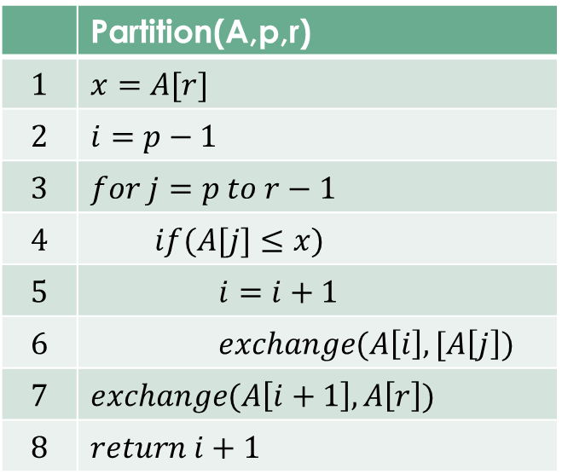
Performance of QS
The running time of quicksort depends on whether the partitioning is balanced or unbalanced
If the partitioning is balanced, the algorithm runs asymptotically as fast as merge sort
If the partitioning is unbalanced, however, it can run asymptotically as slowly as insertion sort.
We investigate now how quicksort performs under the assumptions of balanced versus unbalanced partitioning.
 | Partition(A,p,r)
$$1$$ | $$x=A[r]$$
$$2$$ | $$i=p−1$$
$$3$$ | $$for j=p to r−1$$
$$4$$ | $$if(A[j]≤x)$$
$$5$$ | $$i=i+1$$
$$6$$ | $$exchange(A\left[i\right],[A\left[j\right])$$
$$7$$ | $$exchange(A\left[i+1\right],A\left[r\right])$$
$$8$$ | $$return i+1$$

Slide 4
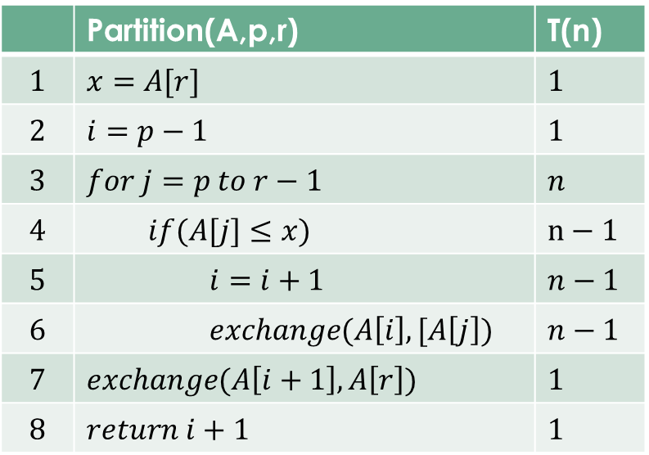

Partition Time Complexity
$T(n)=1+1+n+(n−1)+(n−1)+(n−1)+1+1$
$T\left(n\right)=4n+1$
$T\left(n\right)=O(n)$
However if we exclude the line 5 and 6, the time complexity will remain as $θ\left(n\right)$
As the effect of line 5 and 6 can be absorbed by asymptotic notation so time complexity will result to $θ\left(n\right)$
 | Partition(A,p,r) | T(n)
$$1$$ | $$x=A[r]$$ | $$1$$
$$2$$ | $$i=p−1$$ | $$1$$
$$3$$ | $$for j=p to r−1$$ | $$n$$
$$4$$ | $$if(A[j]≤x)$$ | $$n−1$$
$$5$$ | $$i=i+1$$ | $$n−1$$
$$6$$ | $$exchange(A\left[i\right],[A\left[j\right])$$ | $$n−1$$
$$7$$ | $$exchange(A\left[i+1\right],A\left[r\right])$$ | $$1$$
$$8$$ | $$return i+1$$ | $$1$$

Slide 5
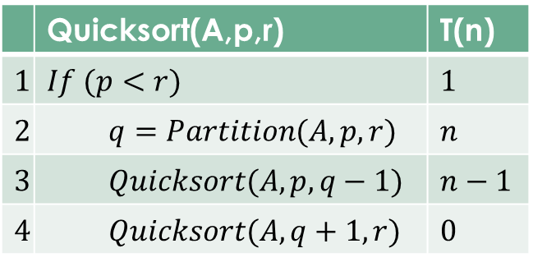

Worst-case partitioning
Worst case occurs when Partition subroutine produces two sub-arrays as follows
$A[p..r−1],A[0],A[q]$or $A[0],A[p…r−1],A[q]$
Let this unbalanced partition occurs in each recursive call
$T\left(n\right)=T\left(n−1\right)+T\left(0\right)+θ\left(n\right)=T(n−1)+θ(1)+θ(n)$
$T\left(n\right)=T\left(n−1\right)+c+θ\left(n\right)= T\left(n−1\right)+θ\left(n\right)=θ\left(n^{2}\right)$
So $n$ times $θ\left(n\right)$ will occur resulting $θ\left(n^{2}\right)$ i.e. $(3x3x3=3^{2})$
Such an unbalanced situation only occurs when the array is already sorted
 | Quicksort(A,p,r) | T(n)
$$1$$ | $$If (p<r)$$ | $$1$$
$$2$$ | $$q=Partition(A,p,r)$$ | $$n$$
$$3$$ | $$Quicksort(A,p,q−1)$$ | $$n−1$$
$$4$$ | $$Quicksort(A,q+1,r)$$ | $$0$$

Slide 6
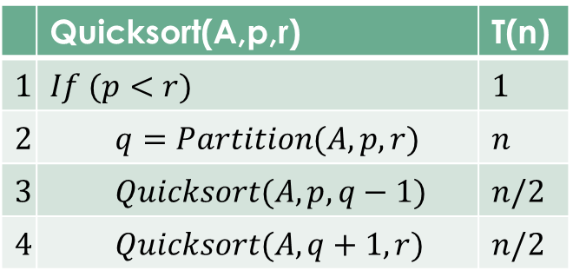

Best Case Performance
Best case occurs when Partition subroutine produces two sub-arrays as follows
$A[p..q−1],A[q+1…r],A[q]$where both arrays are equal
Let this balanced partition occurs in each recursive call
$T\left(n\right)=T\left(\frac{n}{2}\right)+T\left(\frac{n}{2}\right)+θ\left(n\right)=2T(\frac{n}{2})+θ(n)$
By using case-2 of master theorem
$2T\left(\frac{n}{2}\right)+θ\left(n\right)→θ(nlogn)$
In best case, the algorithm runs faster
 | Quicksort(A,p,r) | T(n)
$$1$$ | $$If (p<r)$$ | $$1$$
$$2$$ | $$q=Partition(A,p,r)$$ | $$n$$
$$3$$ | $$Quicksort(A,p,q−1)$$ | $$n/2$$
$$4$$ | $$Quicksort(A,q+1,r)$$ | $$n/2$$

Slide 7
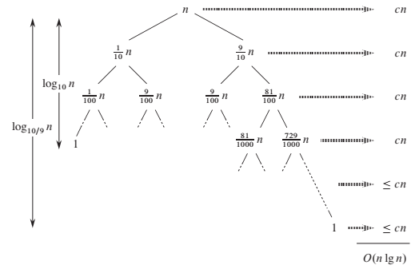

Average Case Partitioning
The average-case running time of quicksort is much closer to the best case than to the worst case
Assume $A[\frac{9}{10}],A[\frac{1}{10}]$ and $A[q]$ partitions
$T\left(n\right)=T\left(\frac{9n}{10}\right)+T\left(\frac{n}{10}\right)+θ\left(n\right)$
For recursion tree
Every level has cost $cn$ except last level
No. of levels in tree is $\log_{10}{n}=θ(logn)$
Cost of each level = $n$
Total cost is $O(nlogn)$
9/10 | 1/10 | A[r]

Slide 8
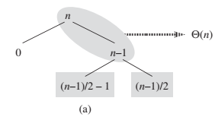
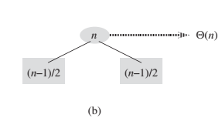
Intuition for Average Case
Let assume an array of 10 numbers
All permutations of these n numbers are equally likely to be input
Except best and worst case, all other permutations show following behavior
Some of the splits by Partition will be balanced
Some of the splits by Partition will be highly unbalanced
In average case, partition produces mix of good and bad splits
In practice these splits will occur randomly
Let suppose that good and bad splits alternate
Let suppose good splits are best cases and bad splits are worse cases

Slide 9


Intuition for average case
Bad splits produces the arrays: $A[0],A[n−1],A[q]$
Good splits produce the arrays: $A[0],A[\frac{n}{2}],A[\frac{n}{2}]$
Both good and bad splits produce three arrays:
$A\left[0\right],A\left[n−1\right],A\left[q\right]→A\left[0\right],A\left[\frac{n}{2}\right],A\left[\frac{n}{2}\right],A\left[q\right]$
Partitioning cost is
$A\left[0\right],A\left[n−1\right],A\left[q\right]→θ(n)$
$A\left[\frac{n}{2}\right],A\left[\frac{n}{2}\right],A\left[q\right]→θ(n−1)$
$θ\left(n\right)+θ\left(n−1\right)→θ(n)$
Cost of bad split is balanced by cost of good split
Cost of alternating splits tends to average case but with larger constant hence the cost is
$O(nlogn)$
$$A\left[0\right],A\left[\frac{n}{2}\right],A\left[\frac{n}{2}\right]→A\left[0\right],A\left[0\right],A\left[\frac{n−1}{2}\right],A\left[0\right],A[\frac{n−1}{2}]$$

Slide 10

Thanks for watching
Dr. Sajid Iqbal
Assistant Professor
Department of Computer Science
Bahauddin Zakariya University, Multan
sajidiqbal.pk@gmail.com
YouTube Channel: COMEDXD
Allah Hafiz

